Slide 1
Linux KVM
With ovirt & virt manager
Kevin Lane

Slide 2
What is KVM?
Kernel Based Virtual Machine
  KVM (for Kernel-based Virtual Machine) is a full virtualization solution for Linux on x86 hardware containing virtualization extensions (Intel VT or AMD-V). It consists of a loadable kernel module, kvm.ko, that provides the core virtualization infrastructure and a processor specific module, kvm-intel.ko or kvm-amd.ko. KVM also requires a modified QEMU although work is underway to get the required changes upstream.
  Using KVM, one can run multiple virtual machines running unmodified Linux or Windows images. Each virtual machine has private virtualized hardware: a network card, disk, graphics adapter, etc.
  The kernel component of KVM is included in mainline Linux, as of 2.6.20.
  KVM is open source software.
Bare Metal Hypervisor
  More like Vmware ESXi than Virtual Box or Vmware Workstation

Slide 3
Ovirt vs. virt-manager
oVirt
  The oVirt project is an open virtualization project providing a feature-rich, end to end, server virtualization management system with advanced capabilities for hosts and guests, including high availability, live migration, storage management, system scheduler, and more
Virt-Manager
  In computing, the Red Hat Virtual Machine Manager is a desktop-driven virtual-machine manager application with which users can manage virtual machines (VMs).[1]

Slide 4
Ovirt vs. virt-manager
oVirt
  SMB or Enterprise environments
  Supports multiple “Host” computers
  Enterprise Features
Virt Manager
  Single Machine environment
    Can support multiple “hosts”, but not as robust as oVirt
  Limited Feature Set

Slide 5
oVirt 3.2 Features
Installer
  VDSM now uses tuned profiles for virtual hosts.
  Users can now remove virtual machines while leaving the virtual machine disks as floating disks.
Storage
  Support has been added for storage domain live upgrade.
Infrastructure
  Support has been added for the Windows 8, Windows 8 x64, and Windows 2012 virtual machine operating systems
  Support has been added for live snapshots.
  Smartcard support has been added for virtual machines.
  Support has been added for a certified cloud provider inventory report.

Slide 6
oVirt 3.2 features
Performance
  The performance of the SSL communication between the oVirt Engine and VDSM has been improved with the implementation of SSL session caching, as the engine does not have to perform a new SSL handshake for each request.
  oVirt Engine now uses the PKCS#12 format to store keys, replacing the previous Java Key Store format.
  Memory Overcommit Manager (MOM) is enabled by default for hosts.

Slide 7
oVirt 3.2 features
Virtualization
  Improvements have been made to the quota implementation, including its logic, calculation, and monitoring.
  VDSM hooks have been added for hot plugging and unplugging network interface cards.

Slide 8
oVirt 3.2 features
User Interface
  The "Disks" tab has been added under the "Storage" tab, allowing users to easily view, add or remove disks from each storage domain.
  Support has been added for UTF8 characters including names and descriptions of virtual machines, templates, snapshots, and disk aliases.
  Users can now change the auto-generated name of a virtual machine that was created as part of a pool.
  A new "Network" tab has been added to the main resource tabs, and a "Networks" entry has been added to the Tree pane.

Slide 9
oVirt 3.2 features
Networking
  Users can now dynamically change the network of a running virtual machine without unplugging the virtual network interface card (vNIC), and maintain the device address of the vNIC
  The Guest Agent now reports the IP addresses and internal name of the vNIC to the oVirt Engine
Power Management
  Host power management policies have been improved. Users can define each host's priority to act as a proxy for fencing operations
  Dual-power hosts can now support two power management agents connected to the same power switch.
  Support has been added for iLo2 and iLo4 power management devices.

Slide 10
oVirt 3.2
Optimum oVirt Configuration
  Directory Server (for User Accounts within oVirt)
  DNS Server (for FQDN’s)
oVirt Downloads: http://resources.ovirt.org/releases/
  3.2/tools/ovirt-live-1.0.iso
  3.2/iso/ovirt-node-iso-2.6.1-20120228.fc18.iso
  nightly/iso/ovirt-node-iso-2.6.999-999.2013-2252051.fc18.iso
    for the adventurous!
  nightly/tools/ovirt-node-iso-2.6.999-999.20130311174737gitf364510.670.fc18.iso
    again, for the adventurous!

Slide 11
VIRT mANAGER
The virt-manager application is a desktop user interface for managing virtual machines through libvirt. It primarily targets KVM VMs, but also manages Xen and LXC (linux containers). It presents a summary view of running domains, their live performance & resource utilization statistics. Wizards enable the creation of new vm’s, and configuration & adjustment of a vm’s resource allocation & virtual hardware. An embedded VNC and SPICE client viewer presents a full graphical console to the guest domain.

Slide 12
VIRT mANAGER
Installation
  # yum install virt-manager (Fedora)
  # apt-get install virt-manager (Debian)
Command Line interface
Graphical interface

Slide 13
VIRT mANAGER
Virt-install
  Command line tool for virtual machine installation
Virt-clone
  Command line tool for cloning existing virtual machines
Virt-image
  Command line too for installing virtual machines based on a predefined image
Virt-viewer
  Lightweight tool to interface to a virtual machines graphical interface
    Uses VNC

Slide 14
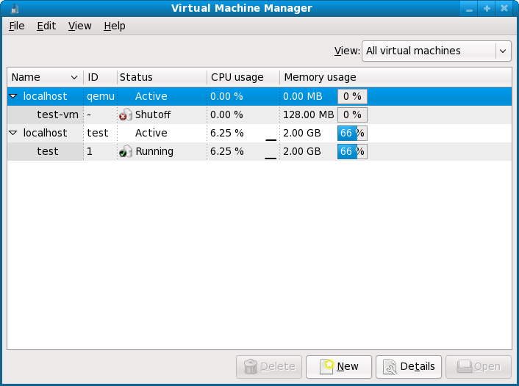

Slide 15
Why use kvm?
More efficient use of existing hardware
  What was once a single Linux machine can now host multiple virtual machines
Low/No Cost solution virtualization
  KVM is OpenSource and Free
  Virt Manager is OpenSource and Free
  oVirt is OpenSource and Free
  Base requirements are included in most modern distributions

Slide 16
Questions?
Resources:
  http://www.linux-kvm.org
  http://en.wikipedia.org/wiki/Kernel-based_Virtual_Machine
  http://www.ovirt.org
  http://virt-manager.et.redhat.com/

